Slide 1
Thermophile Sensor-based Smart System
for
Elderly Fall and Fever Detection
Christopher Silver, Angel Martinez, Shane Davey
Supervisor: Dr. Thangarajah Akilan
Department of Software Engineering
Lakehead University
2022

Slide 2
Outline
Introduction
Problem Statement
Literature Review
Solution
Methods
Demos
Results
Next Steps
Conclusion
Future Work

Slide 3
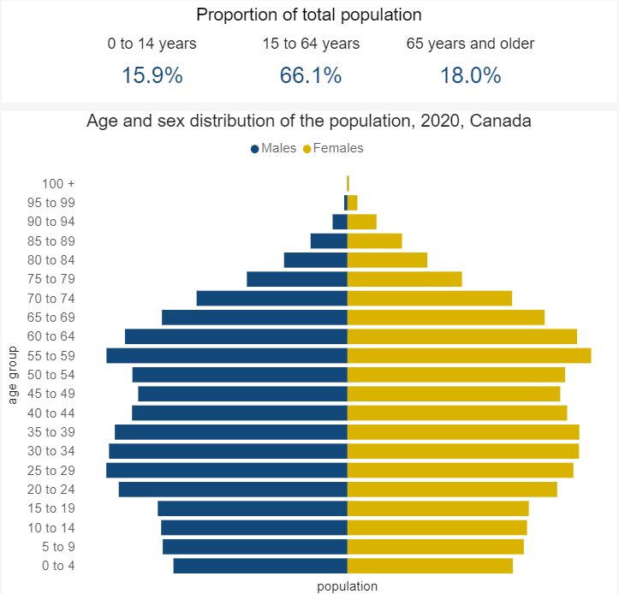
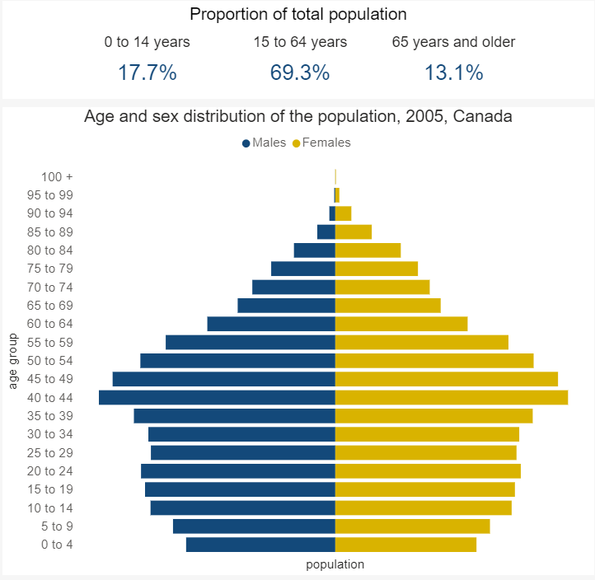
Problem Statement
Canada’s population is aging and will continue to age.
There is already a “crisis” surrounding lack of personal support workers (PSWs).
1 in 4 seniors fall every year [1]
[1] S. C. Government of Canada, “Health at a glance,” Understanding seniors' risk of falling and their perception of risk, 27-Nov-2015. [Online]. Available: https://www150.statcan.gc.ca/n1/pub/82-624-x/2014001/article/14010-eng.htm. [Accessed: 11-Nov-2021].

Slide 4
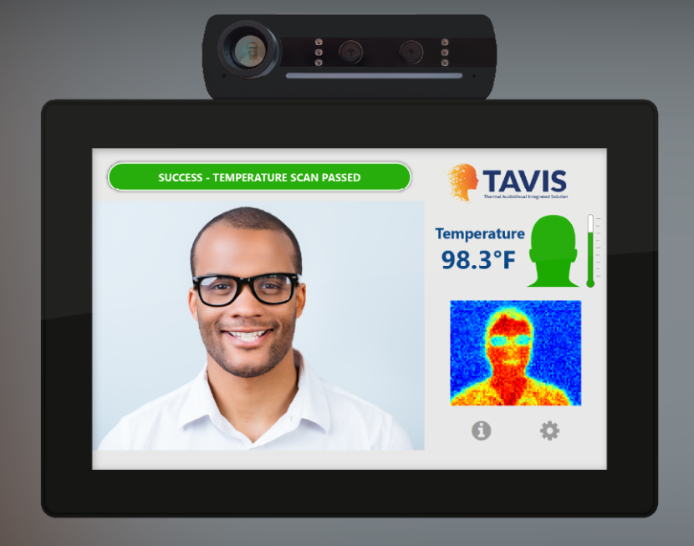
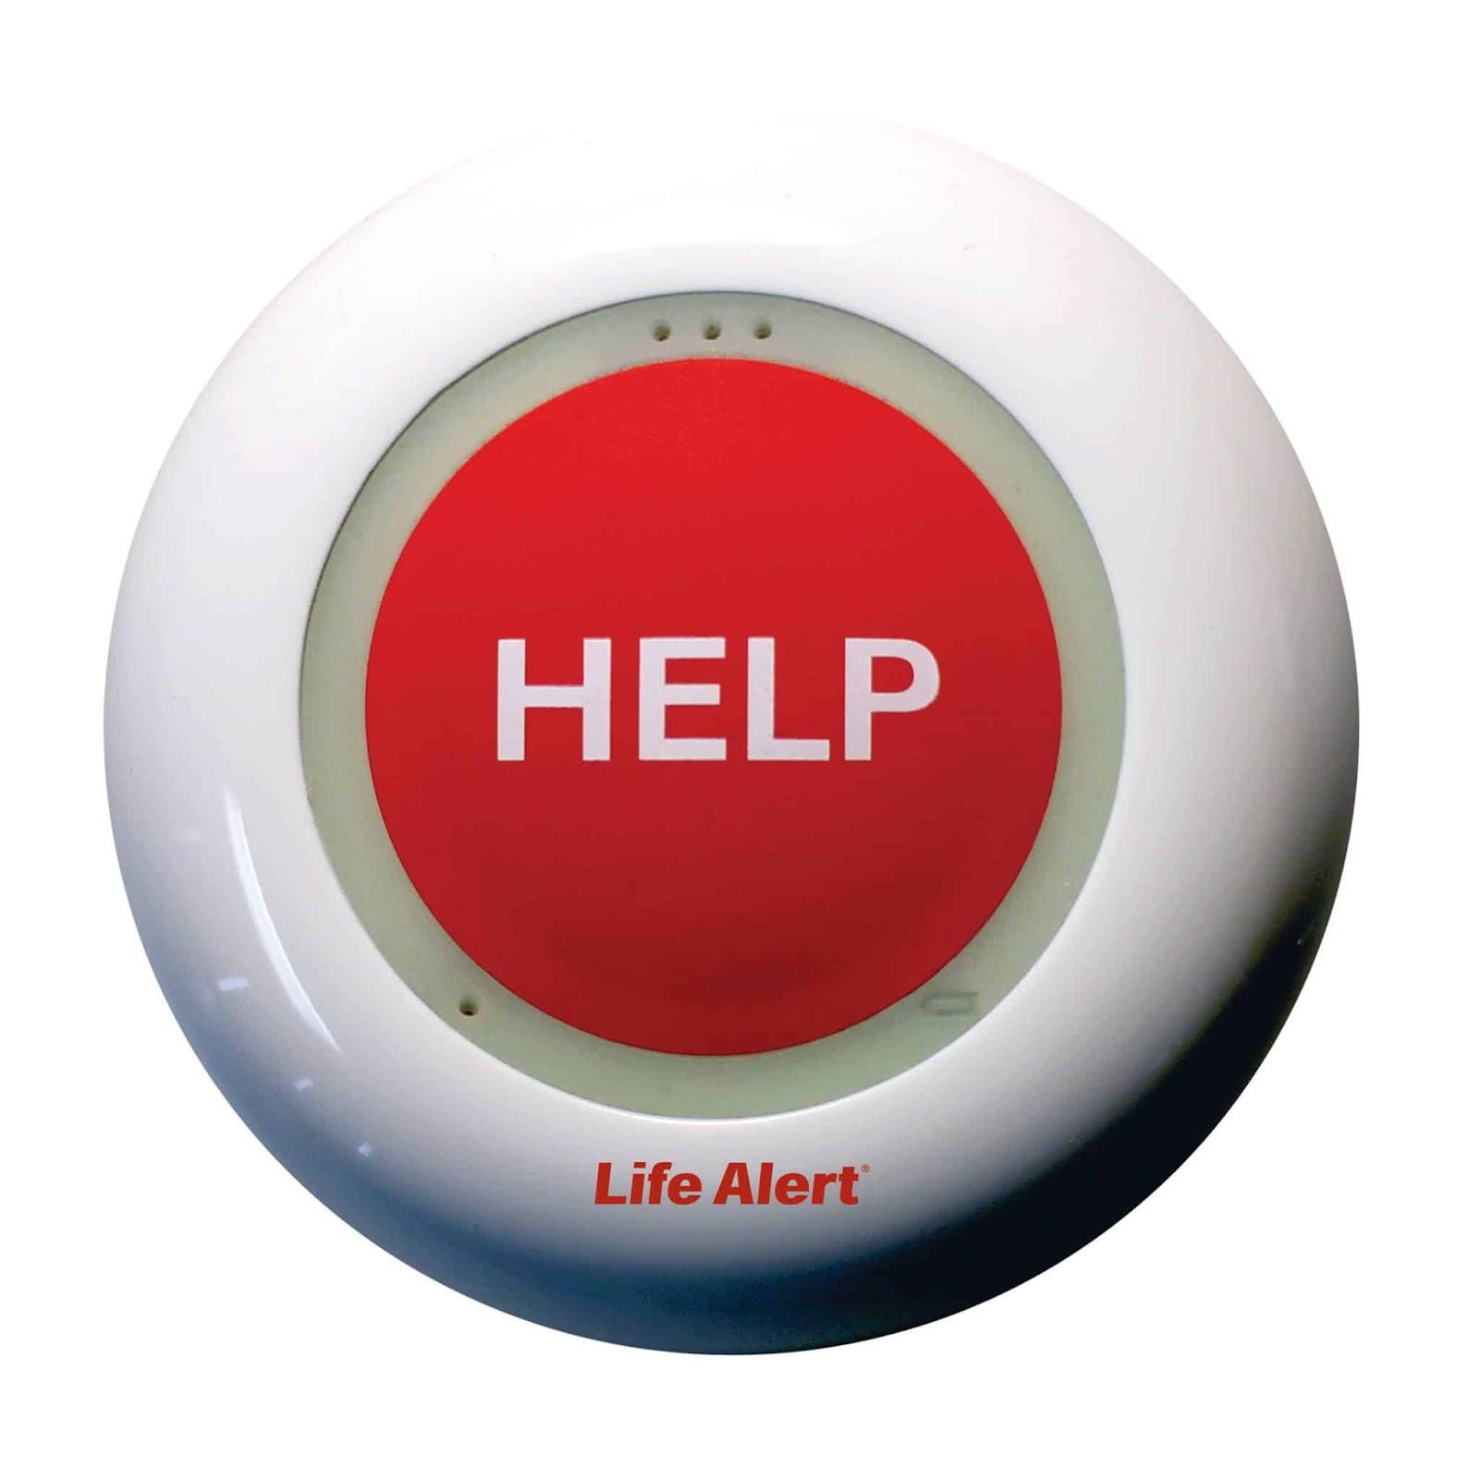
Literature Review 1
Aurora Multimedia
Life Alert

Slide 5
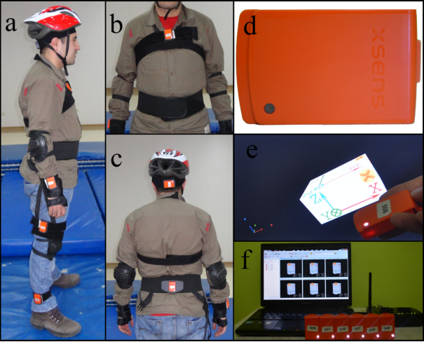
Literature Review 2
Fall detection using wearable sensors
-Ozdemir AT, Barshan B. (2014)

Slide 6
Method

Slide 7
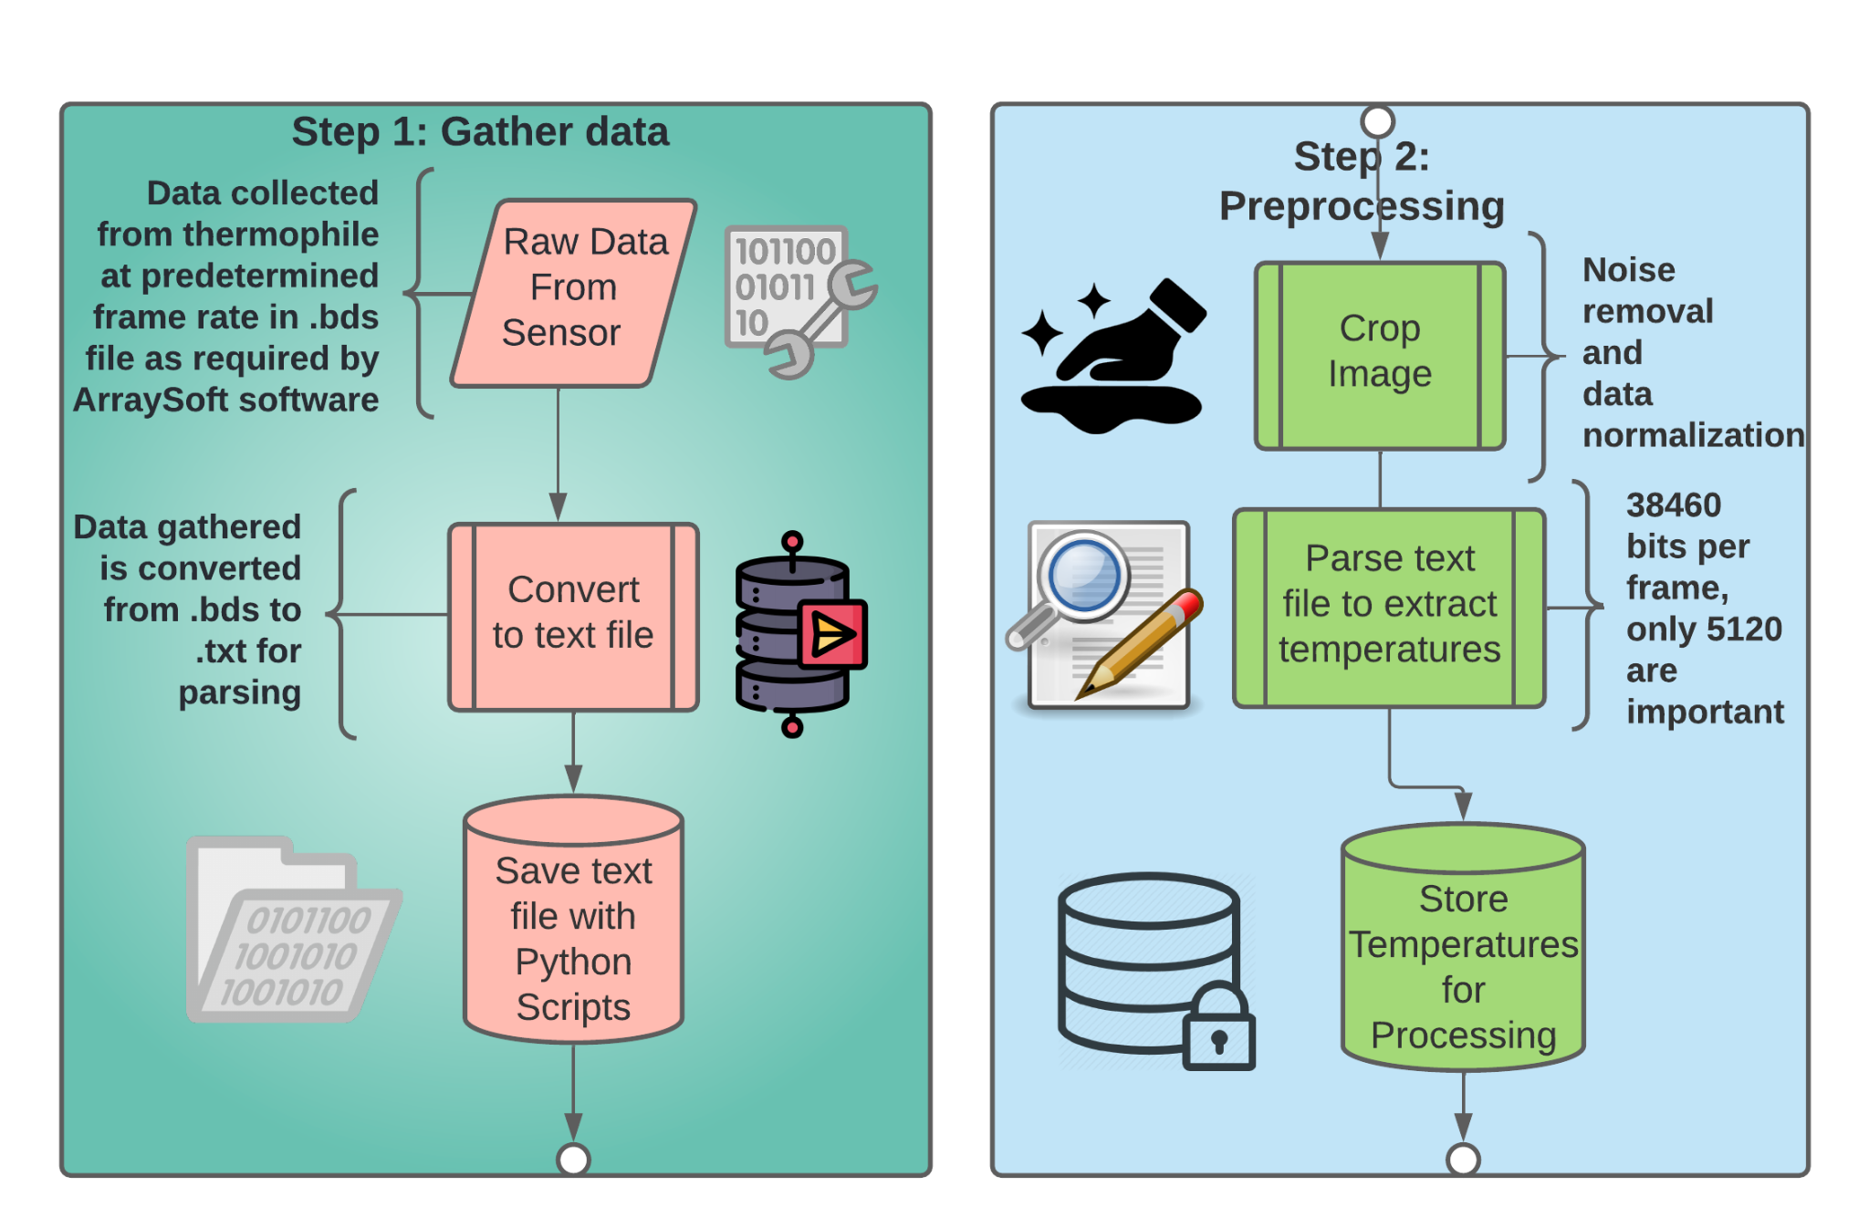
Method - High Level

Slide 8
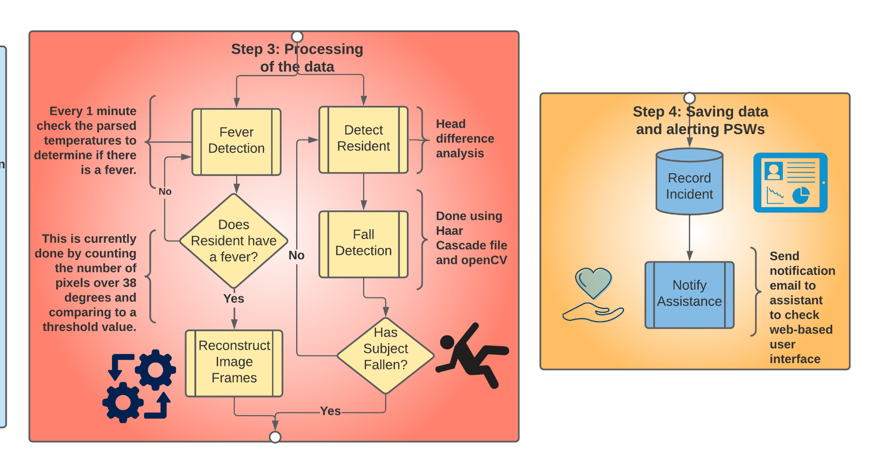
Method - High Level

Slide 9
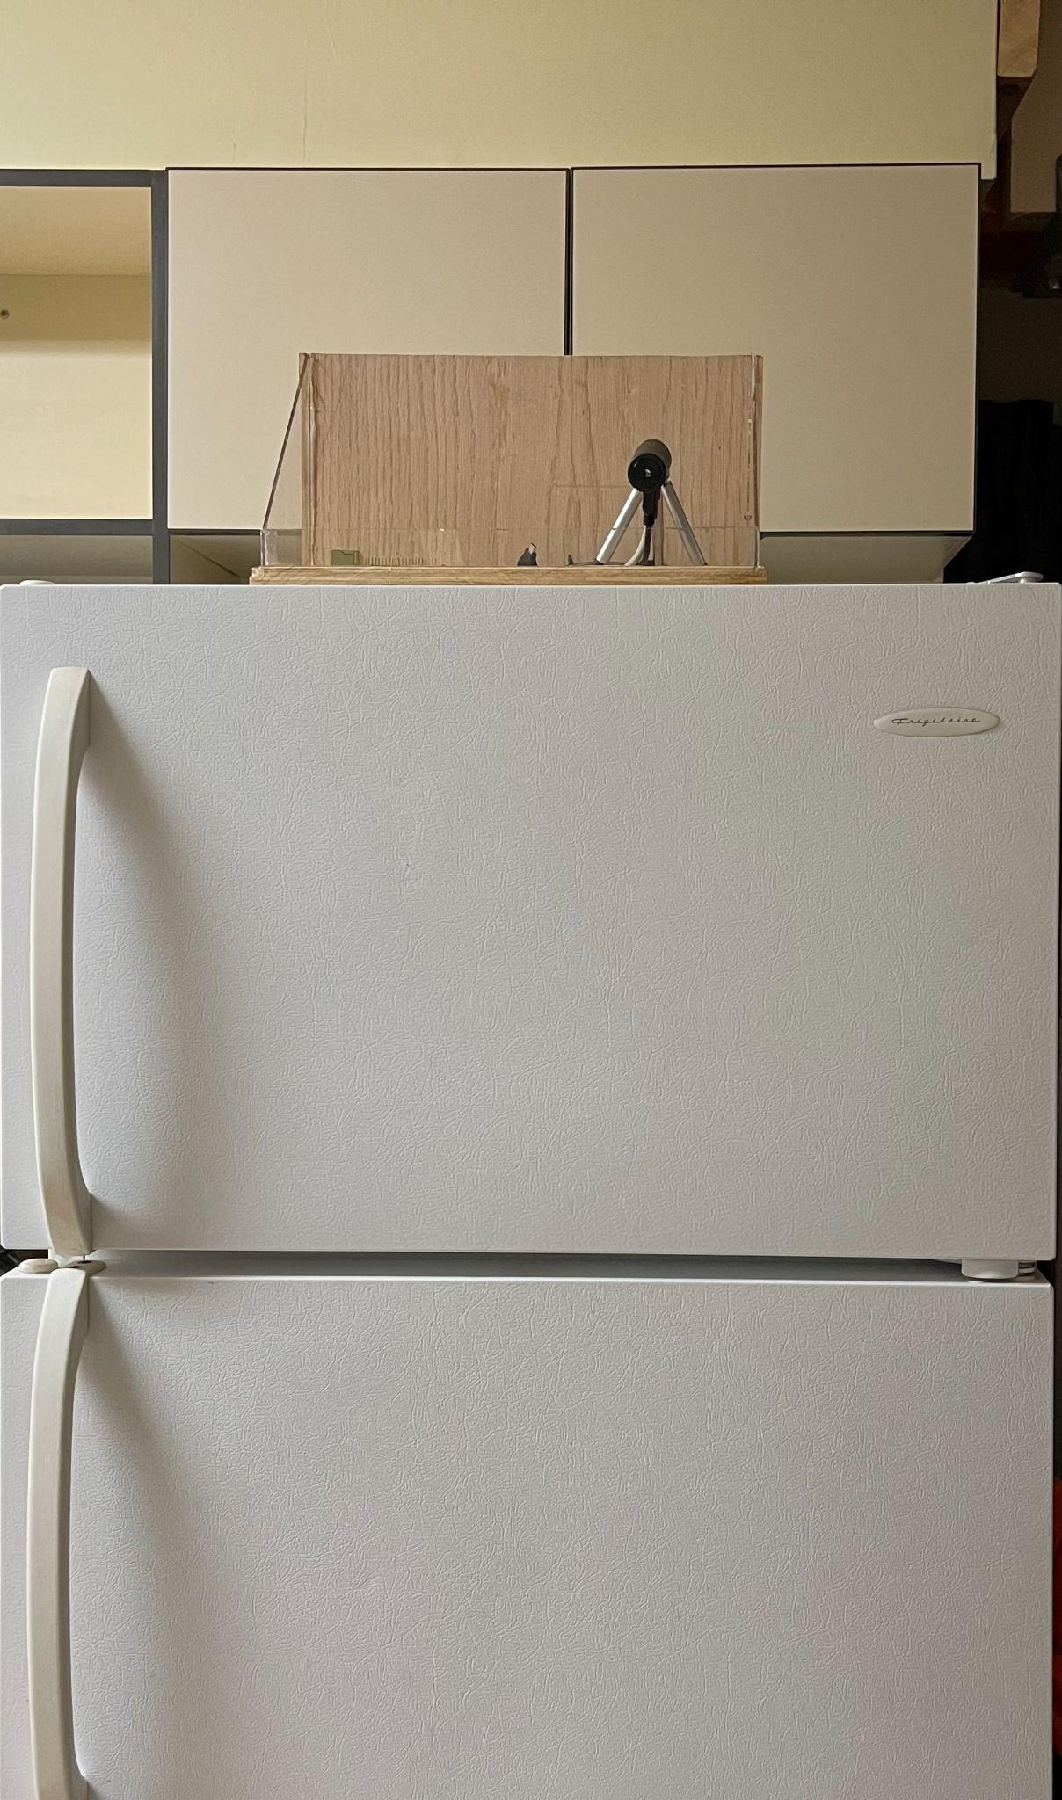
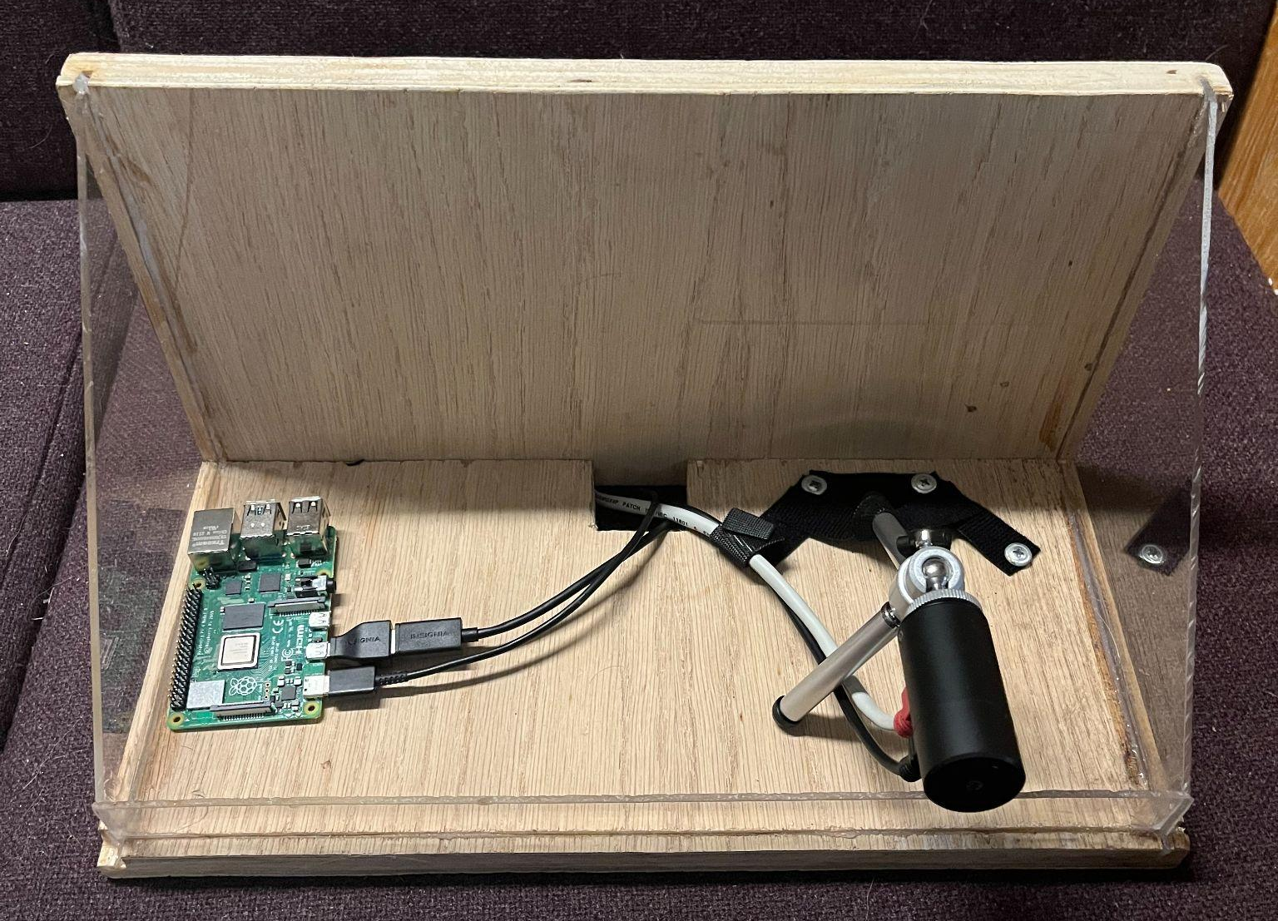
Design Idea

Slide 10
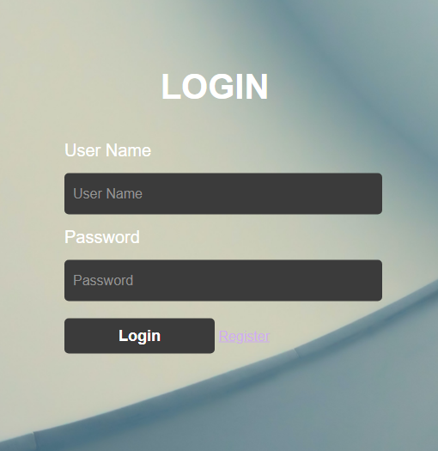
Method - Web Application
Key Components:
User Registration
Account Login
Account Types
Supervisors
PSW’s

Slide 11
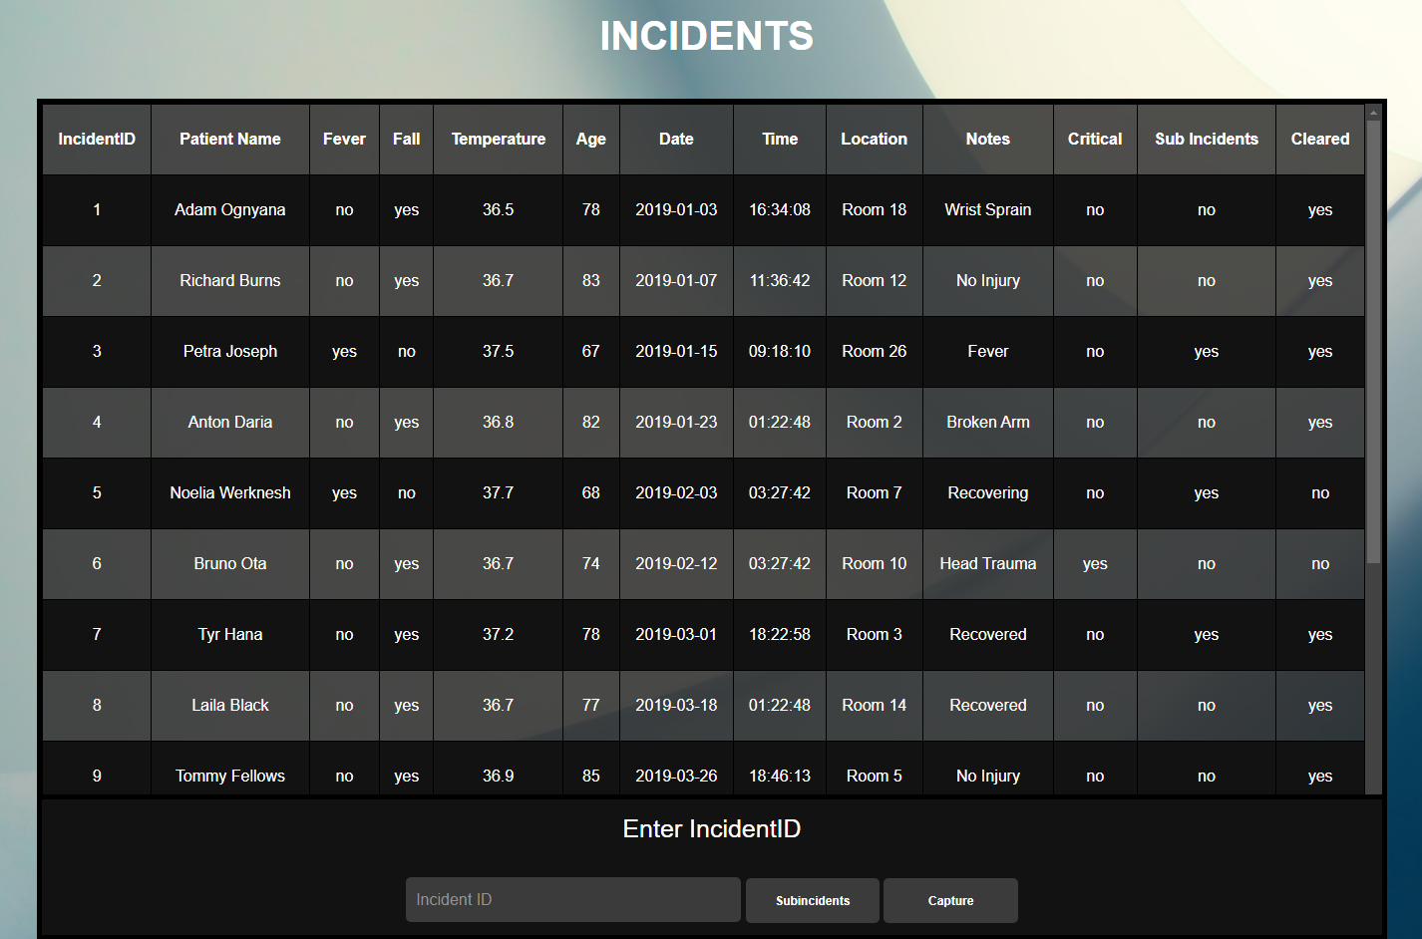
Method - Incidents
Records Incidents
Sub Incidents
Clear Incident
View Patients
Add/Remove
Patients
View Capture

Slide 12
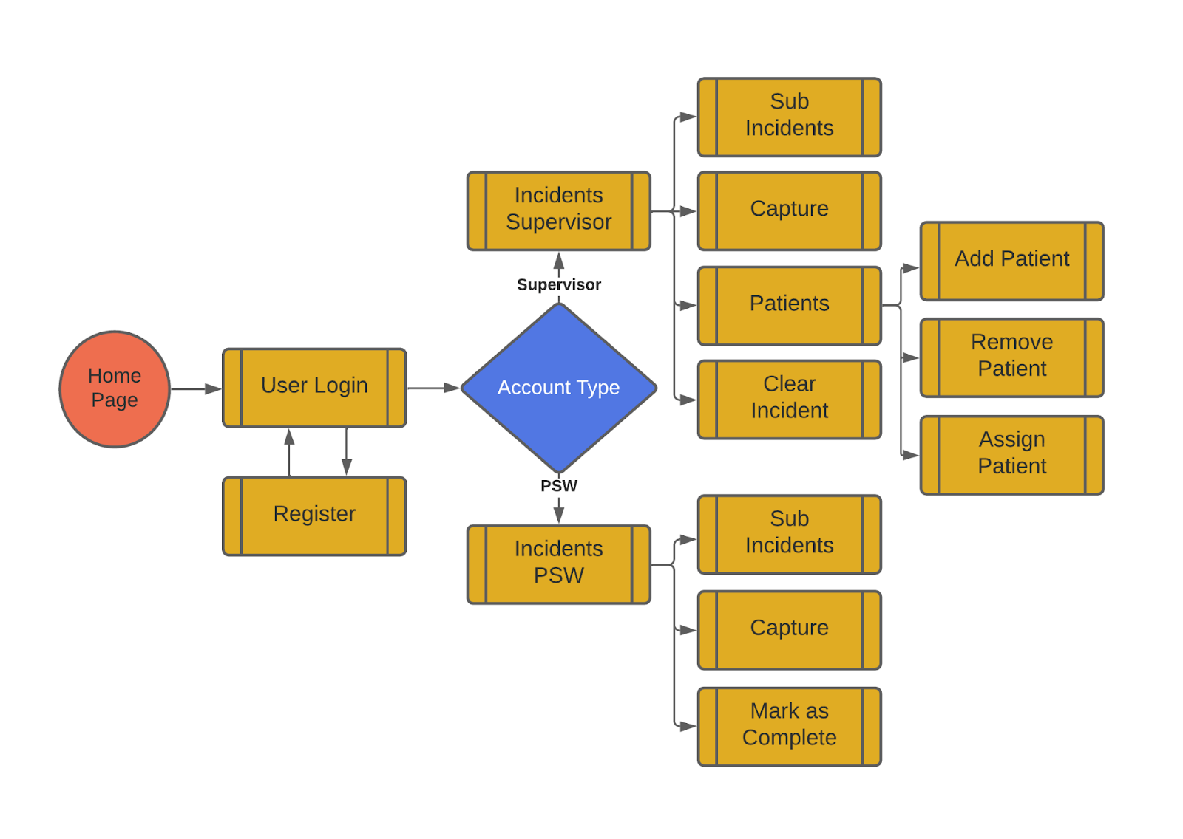
Method - Web Application Design

Slide 13
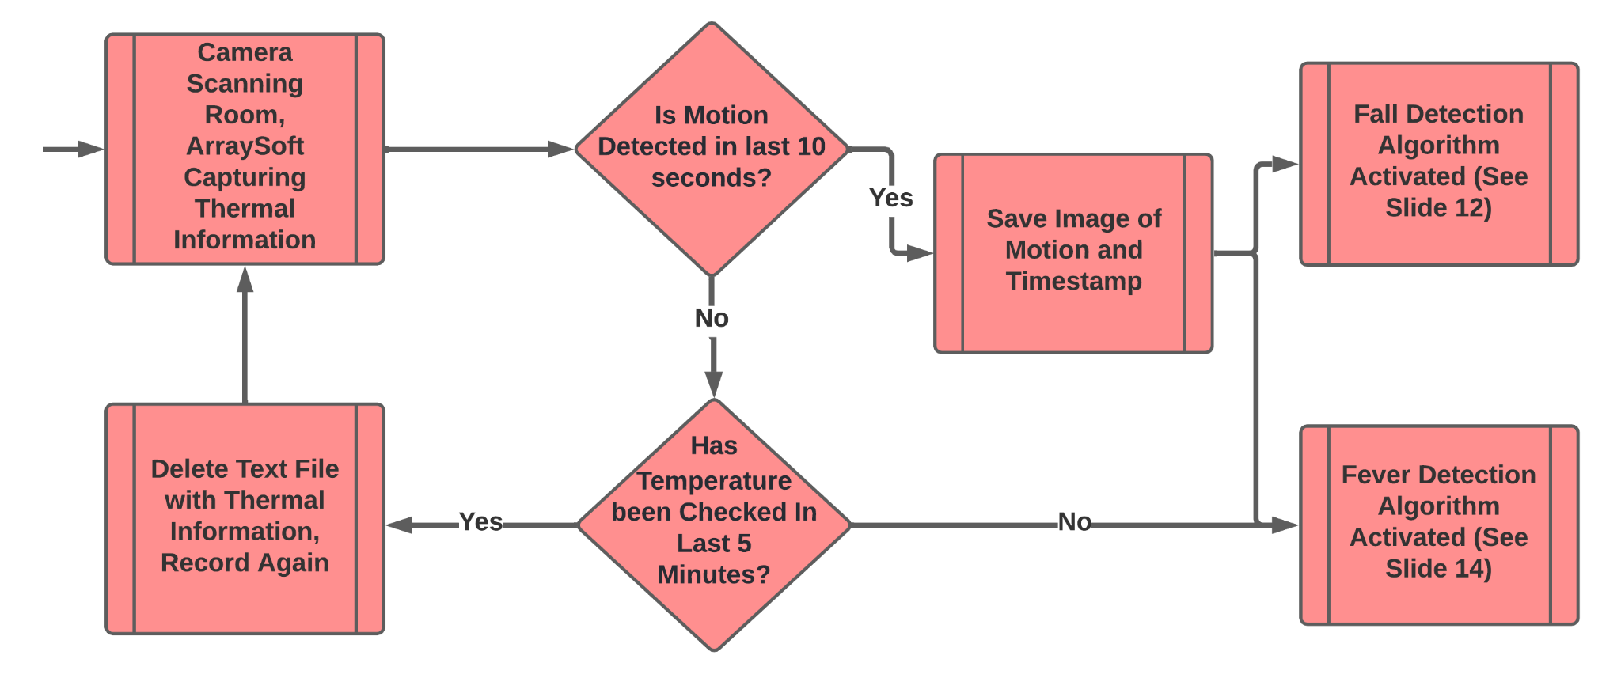
Method - Motion Detection

Slide 14
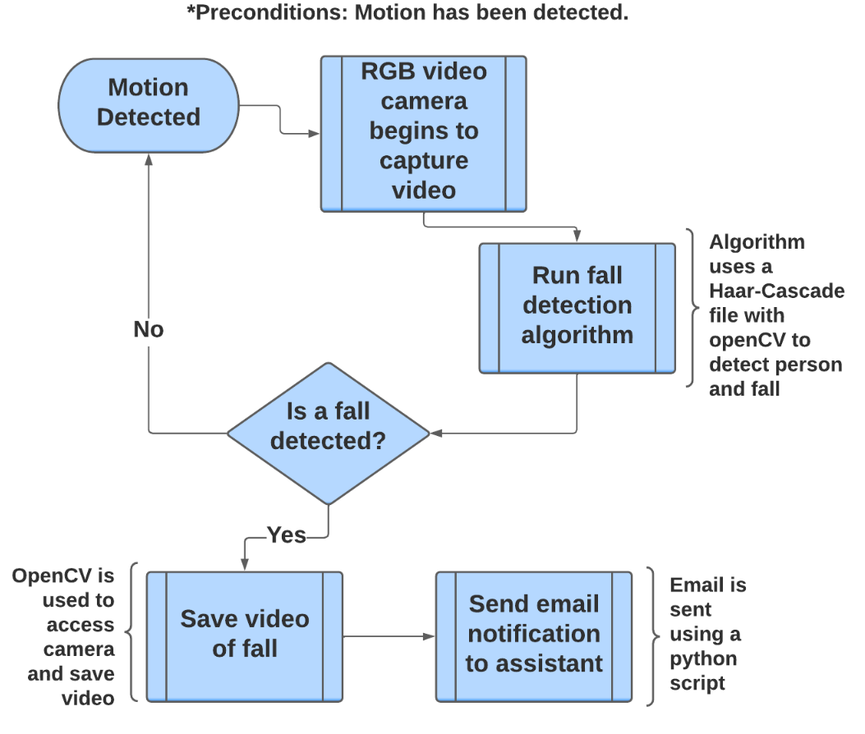
Method - Fall Detection

Slide 15
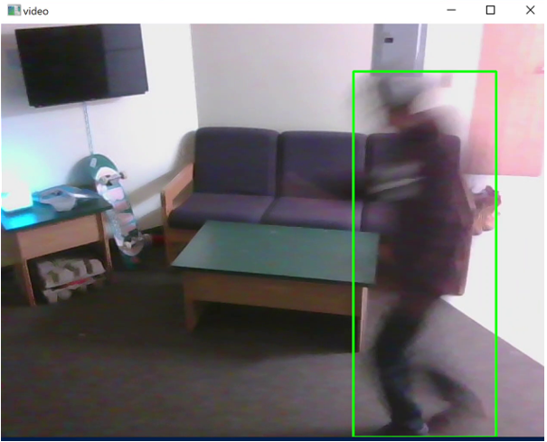
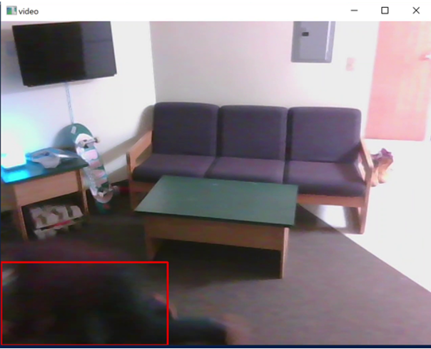
A Fall Detection Scenario
A Frame Before Fall
A Frame After Fall

Slide 16
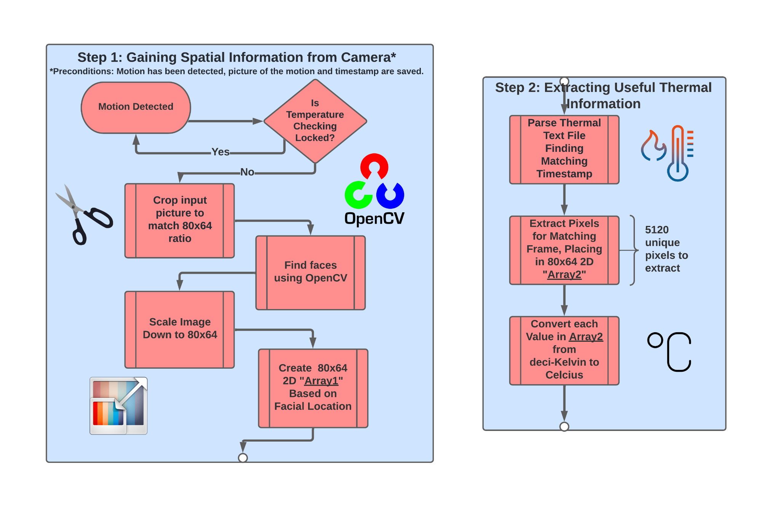
Method - Fever Detection 1

Slide 17
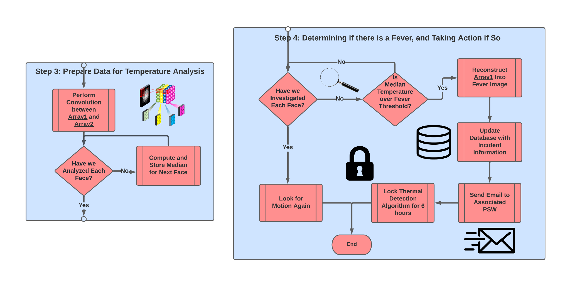
Method - Fever Detection 2

Slide 18
Demo #1
Fall Detection

Slide 19
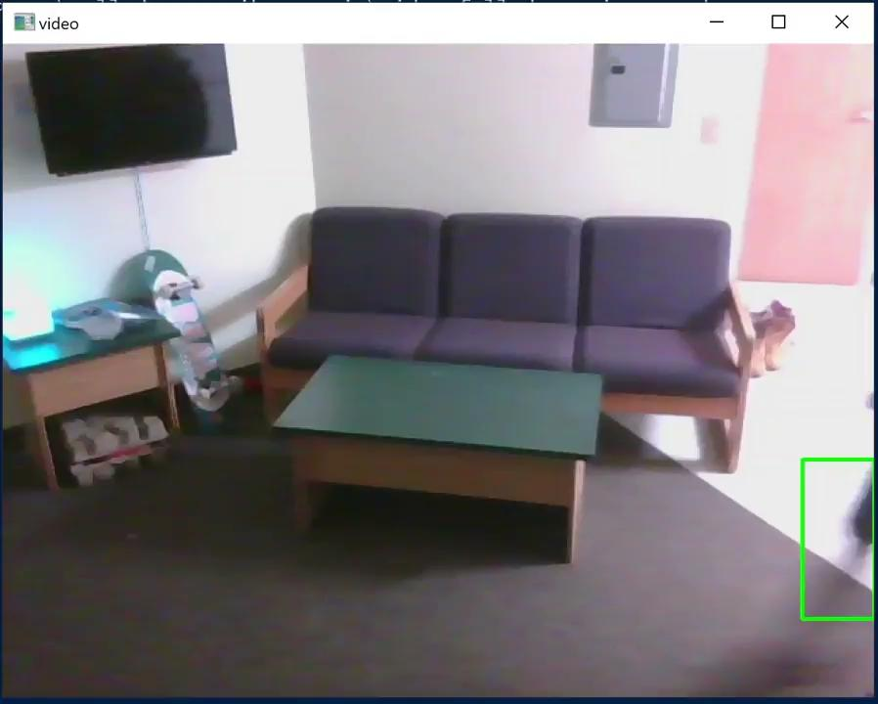
Fall Detection Demo: Scenario 1
Person Falling

Slide 20
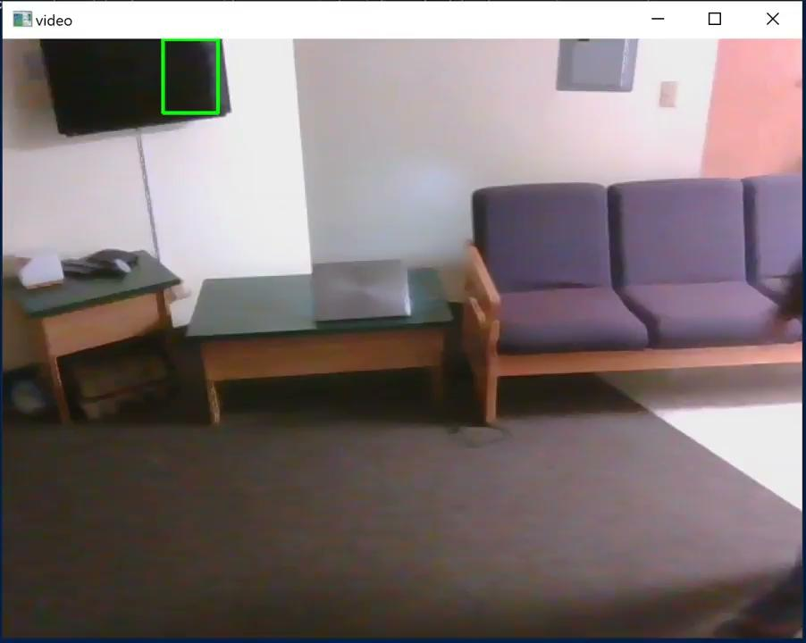
Fall Detection Demo: Scenario 2
Person Stumbling

Slide 21
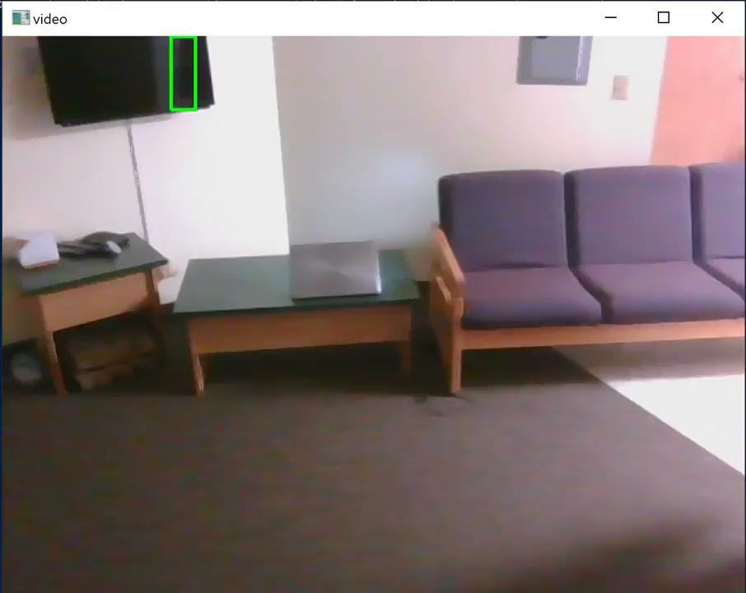
Fall Detection Demo: Scenario 3
Person Walking

Slide 22
Demo #2
Fever Detection

Slide 23
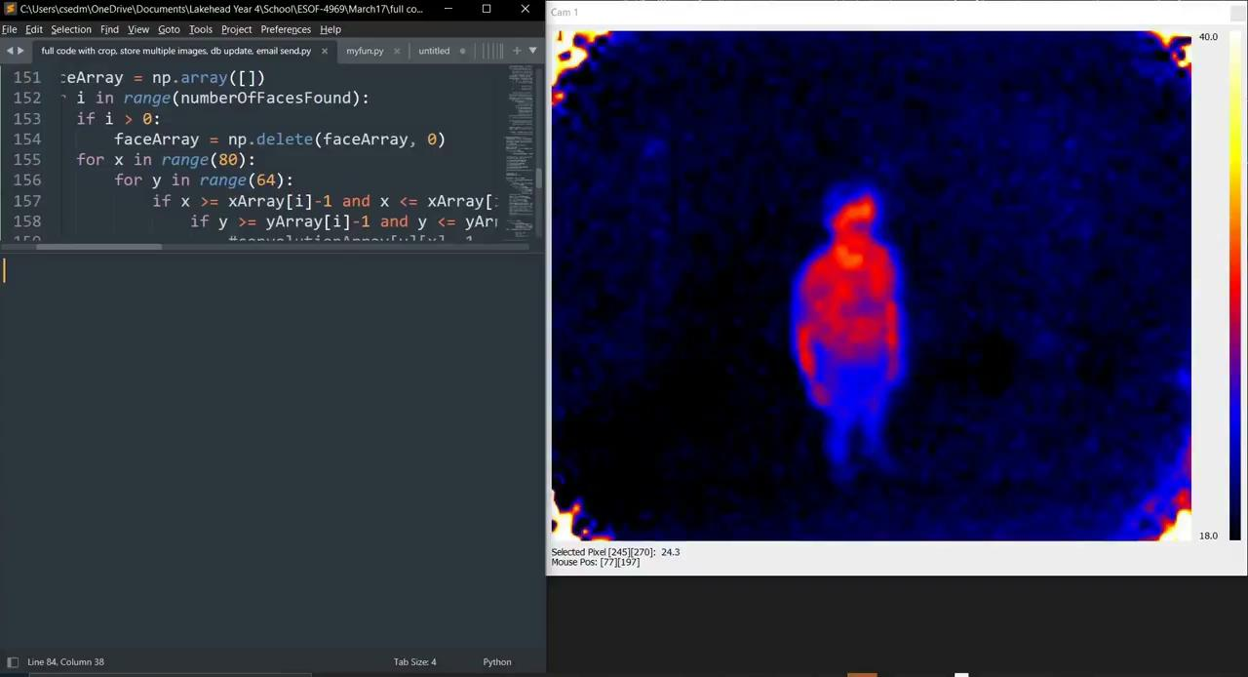
Fever Detection Demo: Scenario 1
2 People No Fevers

Slide 24
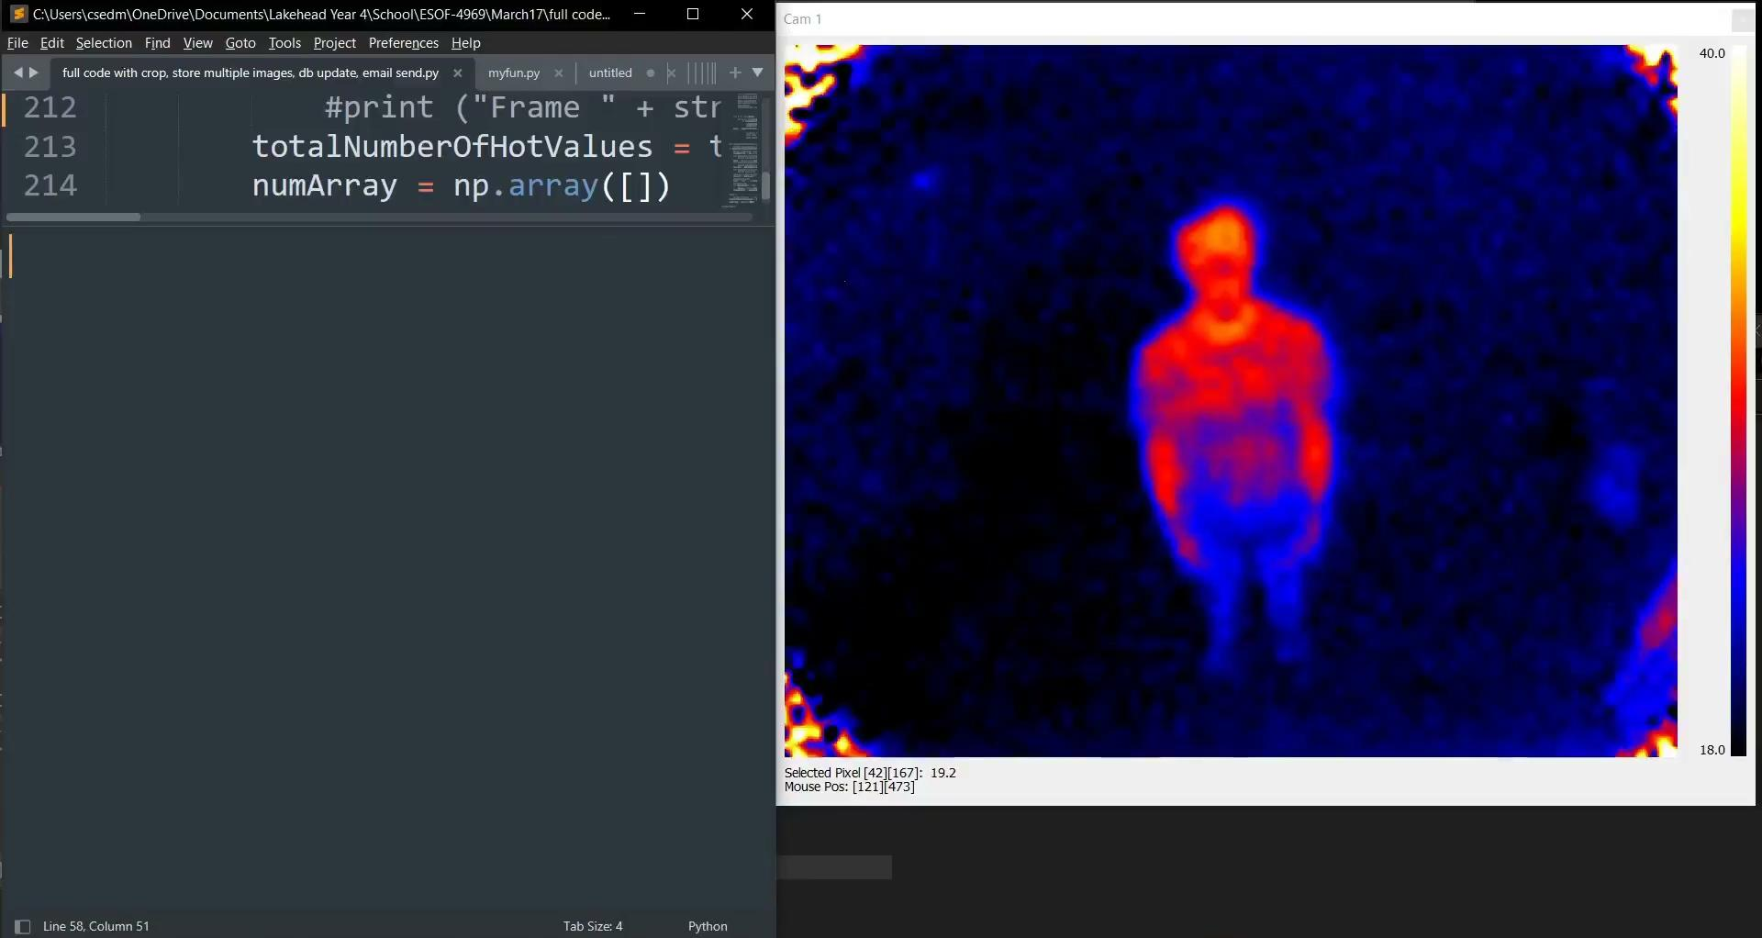
Fever Detection Demo: Scenario 2
1 Person With Fever

Slide 25
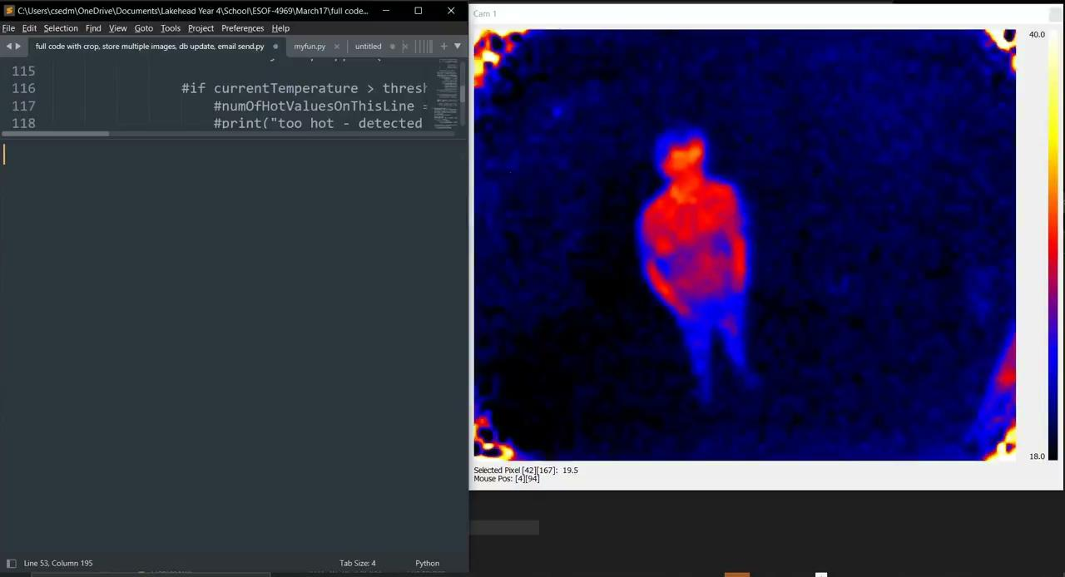
Fever Detection Demo: Scenario 3
1 Person With Fever, 1 Person Without Fever

Slide 26
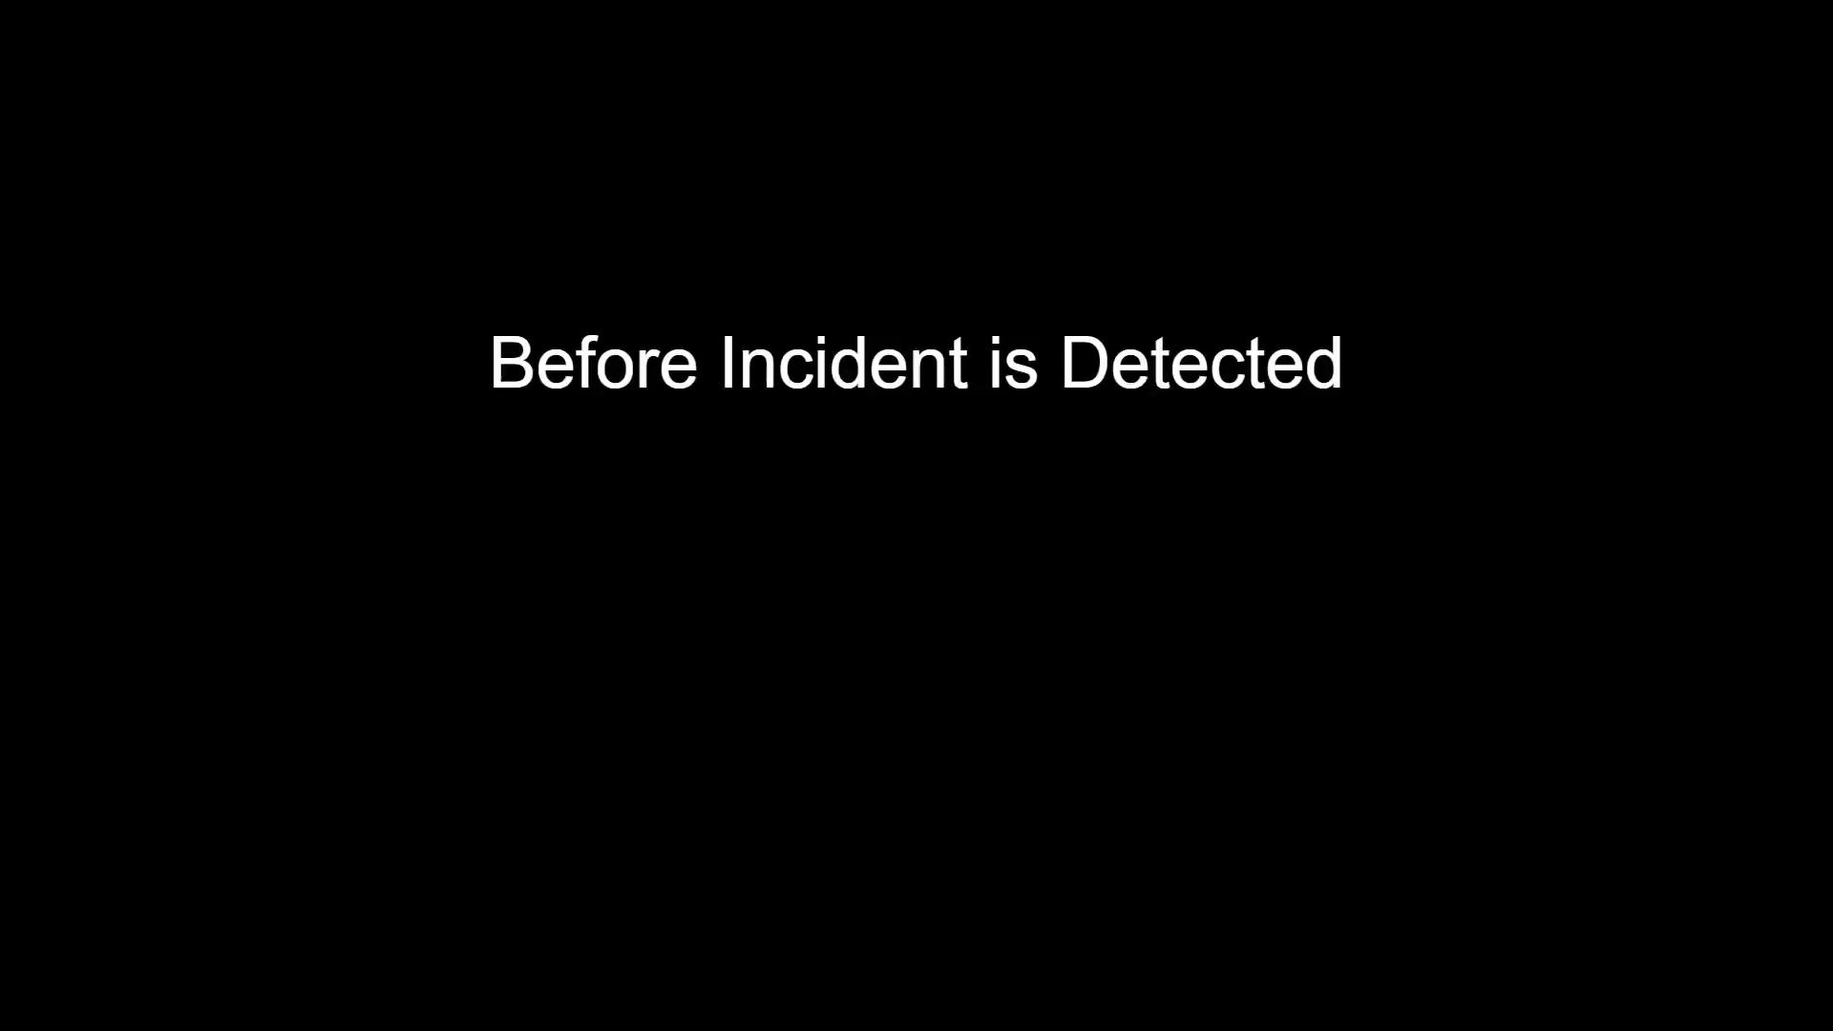
Incident Updated in Web App

Slide 27
Results

Slide 28
Fall Detection Results
Predicted Condition
Total Test Cases: 100 | Fall | Non Fall
Fall | 36 | 14*
Non Fall | 3 | 47
*Because Low Quality Camera Couldn’t See Face
Actual Condition
Accuracy: 83%

Slide 29
Fever Detection Results
Calculated Condition
Total Test Cases: 100 | Fever | No Fever
Fever | 40 | 10*
No Fever | 2** | 48
*Temperature Drop-Off From Range
Actual Condition
**Temperature Drop-Off From Range
Accuracy: 88%

Slide 30
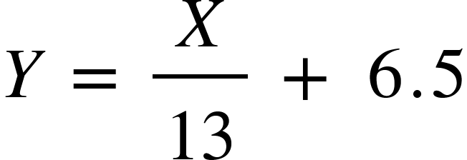
Processing Time
Fall Detection: Real Time. Fever Detection: Batches
Number of Frames | 2 | 21 | 70 | 136 | 1000
Total Time(s) | 6.7 | 8.1 | 11.1 | 17.0 | 81.2
Where Y is Total Time of Execution and X is Number of Input Frames
Bottleneck seems to be parsing.
Time between fever checking : 5 minutes. 1 frame in 5 seconds
Therefore 11.12 seconds of processing every 5 minutes

Slide 31
Cost Analysis
660.41 CAD for hardware (not wholesale)
Raspberry pi
Thermophile sensor
Camera
Estimated 16,992 CAD for development costs
Sell for 749.95 CAD, 148 sold to break even
1116 long-term beds in Thunder Bay
Notes:
For this project we are a team of 3, each of us will spend on average around 5 hours each week developing the product (as specified by the project outline), this will continue over the course of 24 weeks. In total this will bring us to about 24 x 5 x 3 = 360 working hours over the course of development. The average Software Engineer in Canada earns around $47.20 an hour [2], in this case this would bring the cost of development up to 360 x $47.20 = $16,992.

Slide 32
Conclusion
Fever Detection is Accurate if Facial Location is Known
More Advanced Thermopile Needed to Continue
Fall Detection is Accurate in Real Time
With Augmentation, System can Help People

Slide 33
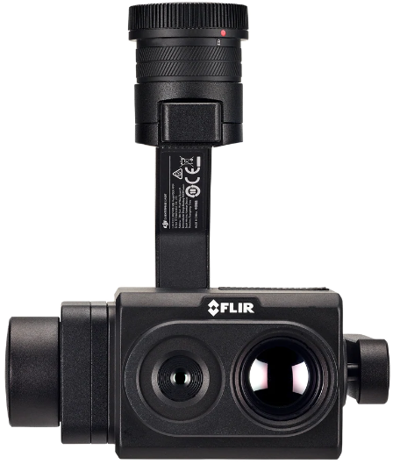
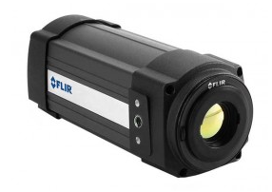
Future Work
Upgrade Sensor Hardware
Read in Sensor Data in Real Time
Detect Falls Using Thermal Sensor (this helps protect people’s privacy)
More Compact Hardware Design
Incident Videos Instead of Images

Slide 34
Acknowledgment
Haar Cascade file obtained from EikeSan public code distribution
“Pitch It” Competition by Lakehead Ingenuity
Lakehead University Undergraduate Student Research Conference
Thank you Dr. Akilan for motivating us to join the above events and guiding us throughout the project

Slide 35
Bibliography
Ozdemir AT, Barshan B. Detecting Falls with Wearable Sensors Using Machine Learning Techniques. Sensors. 2014; 14(6):10691-10708.https://doi.org/10.3390/s140610691
Y. Zheng, D. Zhang, L. Yang and Z. Zhou, “Fall detection and recognition based on GCN and 2D Pose,” 2019 6th International Conference on Systems and Informatics (ICSAI), 2019, pp. 558-562, doi: 10.1109/ICSAI48974.2019.901010197
Fitwi A, Chen Y, Zhu S, Blasch E, Chen G. Privacy-Preserving Surveillance as an Edge Service Based on Lightweight Video Protection Schemes Using Face De-Identification and Window Masking. Electrons. 2021; 10(3):236. https://doi.org/10.3390/electronics10030236
A. Gupta, S. Maurya, N. Mehra and D. Kapil, "COVID-19: Employee Fever detection with Thermal Camera Integrated with Attendance Management System," 2021 11th International Conference on Cloud Computing, Data Science & Engineering (Confluence), 2021, pp. 355-361, doi: 10.1109/Confluence51648.2021.9377079
Moisello, Elisabetta et al. “Thermal Sensors for Contactless Temperature Measurements, Occupancy Detection, and Automatic Operation of Appliances during the COVID-19 Pandemic: A Review.” Micromachines vol. 12,2 148. 3 Feb. 2021, doi:10.3390/mi12020148

Slide 36
Q&A Session

